Slide 1
Bridging the Digital Divide
Update -- December 9th, 2021

Slide 2
Digital Equity & Literacy in Southern Chester County
Too many of our citizens
are not able to realize
the potential of digital technology
because of limited /no
internet access at home
And even if they have access to
digital technology, they do not have the digital literacy skills to effectively use it
This Must be a PRIORITY ISSUE for us
We Need to MAKE THIS BETTER NOW
2

Slide 3
The digital divide is the gap between those who have affordable access, skills, and support to effectively engage online and those who do not.
As technology constantly evolves, the digital divide prevents equal participation and opportunity in all parts of life, disproportionately affecting people of color, Indigenous peoples, households with low incomes, people with disabilities, people in rural areas, and older adults.
National Digital Inclusion Alliance
3

Slide 4
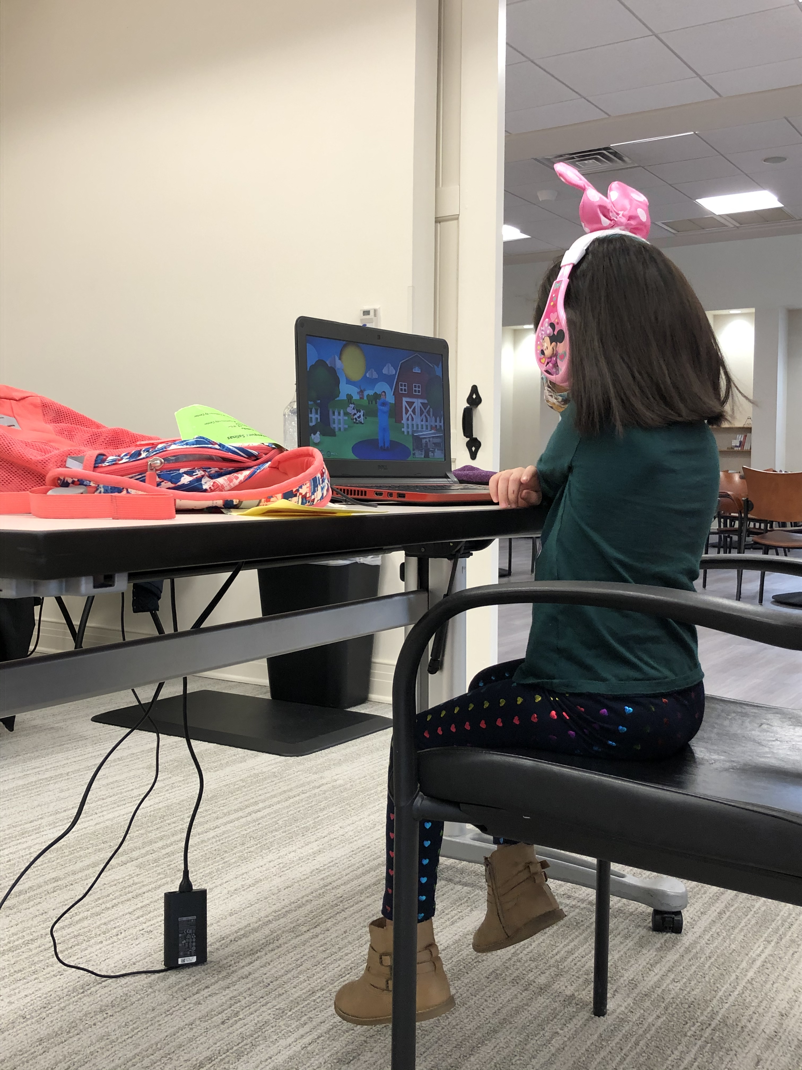
SCCON’s Volunteer Leadership Creating Collaborative Action
Learning Pods serving the most vulnerable students
Parent Education committee working together to communicate & provide resources to support parents
Technology group launching advocacy initiative to campaign for ongoing universal broadband connection
4
Notes:
Dan Maguire; Justin Webb

Slide 5
Digital Connectivity Timeline
March 4th
Summer/ Fall
Fall/
Winter
2022
Community Presentation
Project Setup
Broadband Access Study
Implementation
Officials – County, State, Municipalities, Community
Project Lead
Funding Request
CCIU Leads
Funding Secured
RFP Developed and Released
Consultant Chosen
Current Connectivity
Current Accessibility
Options & Recommendations
Cost
Timeline
Officials Sign-off
Coordination with ISPs & local officials
Enhanced Connectivity & Accessibility
Funding as needed
5

Slide 6
Broadband Access RFP Timeline
June
September
October
November
Project Approved
RFP Released
Vendor Evaluation
Approval
County Commissioners Approval
Dept of Labor Grant
Stakeholder Outreach
CCIU Released RFP
Vendor Proposals Submitted
Vendor Evaluation
CCIU Board Approved Magellan Advisors, LLC to conduct Broadband Feasibility Study
6
Notes:
Jessica Sahl

Slide 7
Broadband Access Study – Next Steps
Timetable
CCIU will connect Magellan with key stakeholders
Magellan is drafting surveys for community residents
CCIU and Magellan will work with stakeholders to maximize resident response to surveys
CCIU and Magellan will conduct stakeholder focus groups and individual interviews
 | Month
Task/Description | 1 | 2 | 3 | 4 | 5 | 6
Task 1: Conduct Market Research and Business Planning (Needs Analysis)
Task 2: Develop and administer online market surveys to evaluate end user speeds
Task 3: Conduct Stakeholder and Public Sector Outreach
Task 4: Develop comprehensive broadband coverage and mapping analysis
Task 5: Develop comprehensive business planning and financial model analysis
Task 6: Federal and state Broadband funding analysis and strategy development
Final Report and Presentations
7

Slide 8
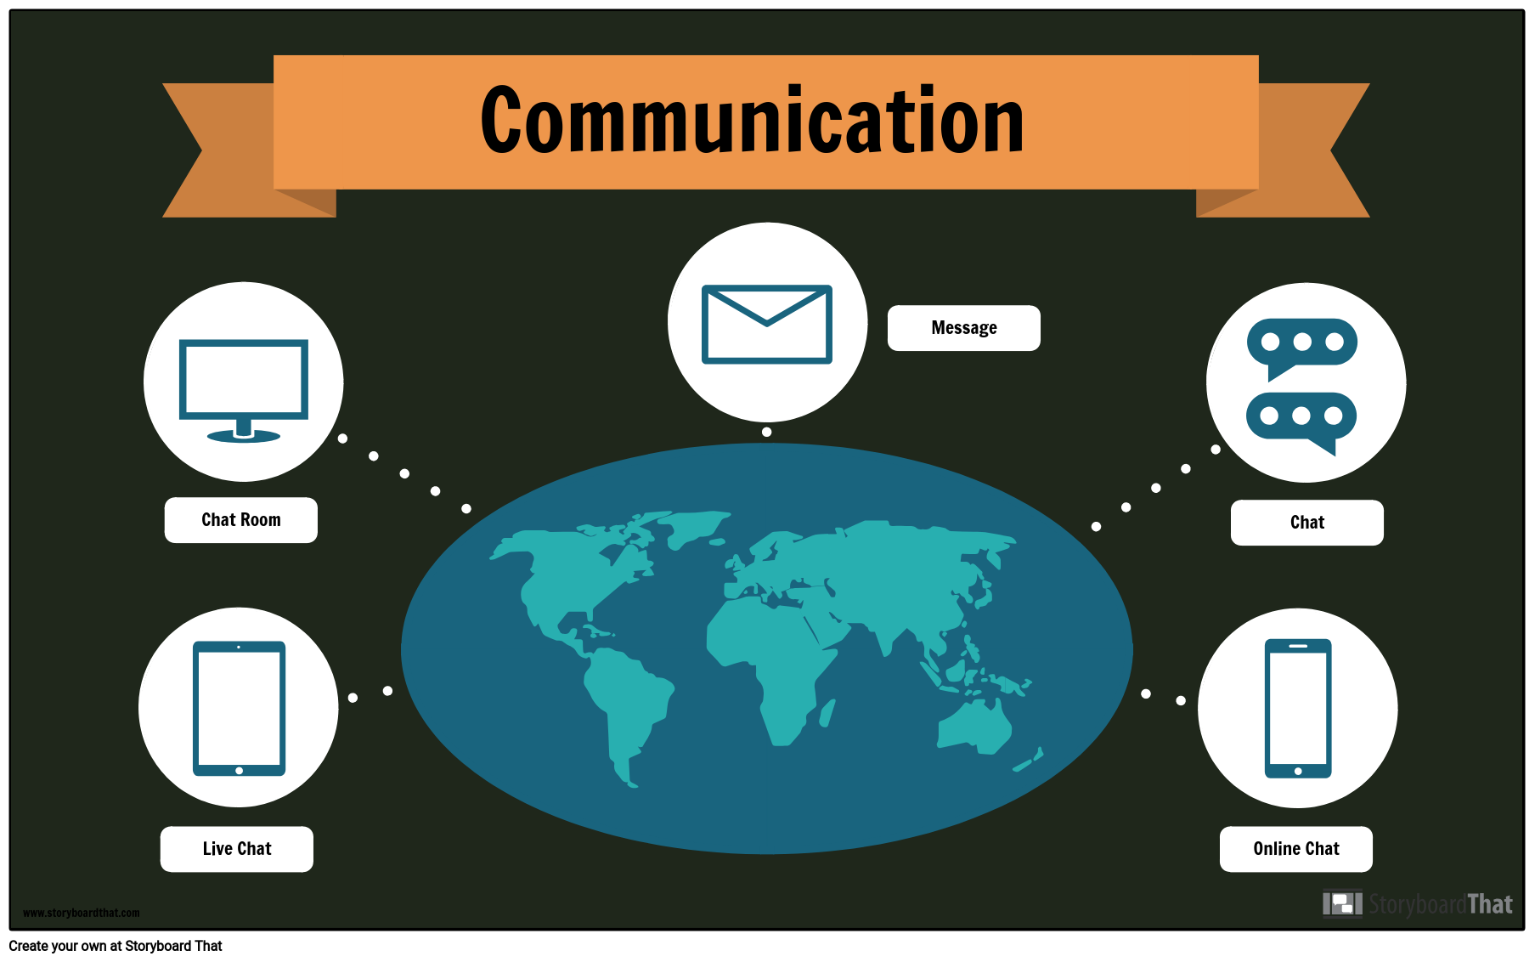
Digital Literacy is the ability to participate in the economy
and culture surrounding information technologies.
Social
Media
Orientation to Computer Skills
Computer
Based
Research
Digital
Literacy
Communication: Zoom, Email, Telehealth
8
Economic/Commerce Participation

Slide 9
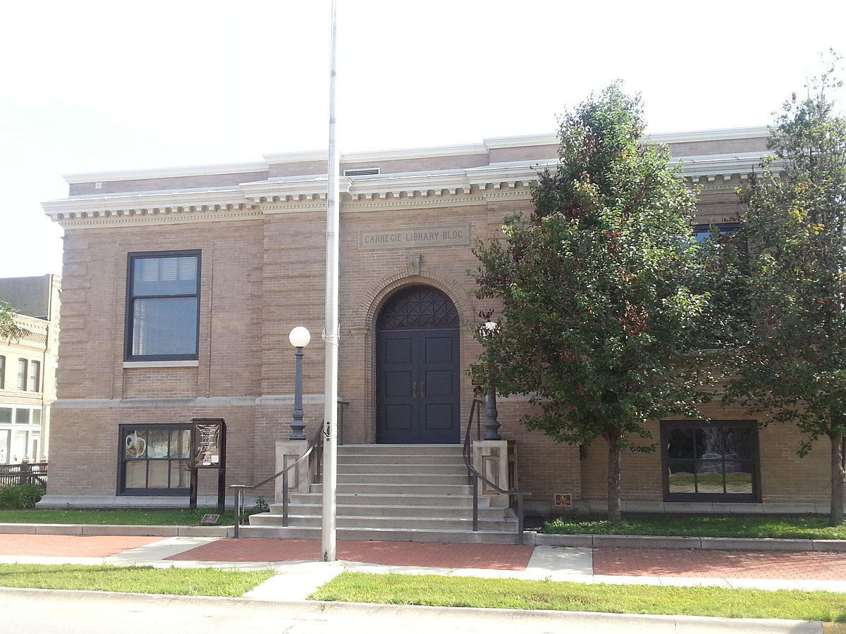
Chester County Digital Literacy Coalition
School Districts & CCIU
Libraries
Internet Service Providers
Community Based Organizations
Funding: Federal – FCC; State/County; Private
9

Slide 10
The Mission of SCC Digital Literacy
To come together as a SCC community initiative to address the inequity around digital literacy
Through providing digital education at required levels for the most vulnerable
So that each and all have access to educational, social and economic opportunities leading to greater community investment.
10

Slide 11
Vision for Digital Literacy
Doors are opened to new potential for achieving good health, employment, education and social connection.
Barriers are removed to becoming an engaged, contributing community member.
A sustainable organization (i.e. library) will carry on the mission.
11

Slide 12
Pilot Agencies for Train The Trainer
Lead Agency for Train The Trainer
Interested Agencies for Train The Trainer
Schools
12
Notes:
Mushroom Industry – American Mushroom Institute

Slide 13
13

Slide 14
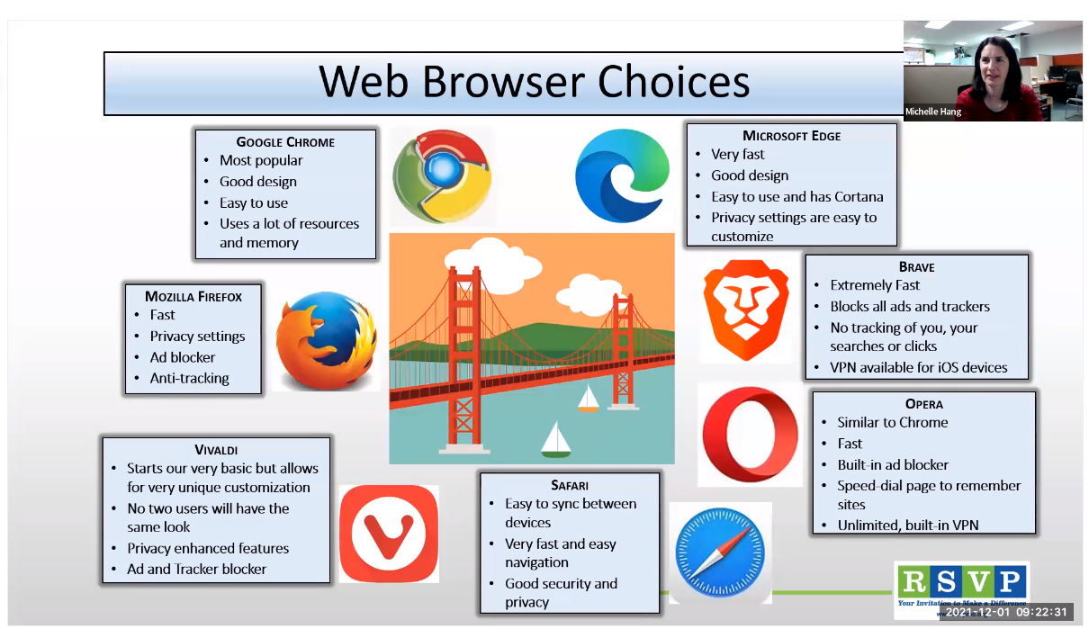
Train the Trainer Curriculum Development
Five modules were identified and are being taught to trainers through weekly Zoom classes
Guide to Internet Safety
Introduction to Email
Web Browsers
Android and iPhone Apps
Zoom
Oasis Connections Curriculum modules were identified and modified to meet the goals of the Southern Chester County Digital Literacy Coalition.
Goals were determined through surveys completed by the three pilot agencies
Curriculum modules are being mailed to trainers. PowerPoint presentations and corresponding classroom materials will be shared electronically with trainers to be used to train students
Modules and PowerPoint presentations are available in both English and Spanish
End of class feedback surveys are completed by participant trainers at the end of each module
14

Slide 15
Path Forward
ASKS
Support, endorsement, consideration for federal funding
Support for equitable broadband access and digital literacy throughout all of Chester County
VISION for long term programs
Digital Access & Literacy offices at the county and state level
Digital Access & Literacy funding included in school districts annual budgets
Libraries as pivotal centers for digital literacy throughout Chester County
15

Slide 16
Concluding Thoughts
16

